Slide 1

CS 584 Machine Learning
Week 9
March 13, 2019

Slide 2

Week 9 Agenda: Dimension Reduction
Feature Selection
Principal Component
Chapter 6 of the Machine Learning book

Slide 3
Feature Selection Before Model Selection
In the era of Big Data (including Noisy Data), Model Selection is not the first thing to do
Resources (e.g., memory, disk space, CPU speed) limit the number of variables that you can feed into a computer program
The machine is not very good at dealing with collinearity (most, if not all, computer program simply choose one and throw away others to deal with collinearity)
We need a good practice of selecting features!

Slide 4
Feature Selection
Select features based on business practice
Select features to discard the “bad apples” or “troublemakers”
Select features that help predict the target variable
If you have a difficult time choosing one over the others, then consider combining features

Slide 5
Feature Selection – Business Practice
Features that must be considered whatsoever due to business practice
Geographical tiers in insurance ratemaking
Marketing incentive in customer purchase behavior
Features that must never be included to avoid regulatory issues or legal litigations
Race, Gender, Age, Disability Status are avoided in human resources analytics
Protected Health Information and Personally Identifiable Information are seldom used to minimize the chance of any breach of privacy.

Slide 6
Feature Selection – “Troublemakers”
Features that vary too much or too little
Record identifiers (unique value for each record)
Constant or nearly constant features (percent of observations tie to a particular value must be less than a threshold)
Features that are practically all missing values
Percent of non-missing observations must be above a threshold
Features that vary over a narrow range relative to others
Unit of measurement may not be appropriate (e.g., the distance of your house from nearest fire hydrant should not in inches or miles)

Slide 7
Feature Selection – “Helpful Predictors”
When we have too many features available for predicting the target, it may not necessarily be a good thing.
Although many machine learning algorithms may have built-in some feature selection option (e.g., forward, backward, and stepwise), this option is effective only if we can specify that many input features.
Our job here is pre-qualify a subset of input features for predicting the target variable.

Slide 8
Feature Selection – “Helpful Predictors”
Appropriate Statistical Test |  | Target Variable
 |  | Categorical | Interval
Predictor | Categorical | Chi-Squares | ANOVA
 | Interval | Likelihood Ratio | Regression

Slide 9
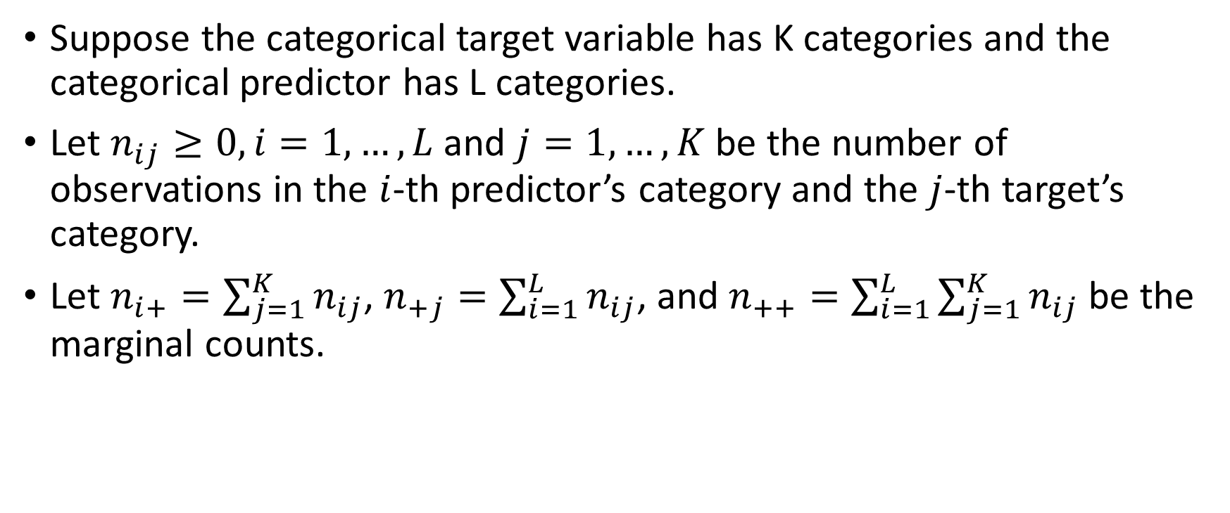
Chi-Squares Test
Suppose the categorical target variable has K categories and the categorical predictor has L categories.
Let $n_{ij}≥0, i=1,…, L$ and $j=1,…,K$ be the number of observations in the $i$-th predictor’s category and the $j$-th target’s category.
Let $n_{i+}=\sum_{j=1}^{K}{n_{ij}}$, $n_{+j}=\sum_{i=1}^{L}{n_{ij}}$, and $n_{++}=\sum_{i=1}^{L}{\sum_{j=1}^{K}{n_{ij}}}$ be the marginal counts.

Slide 10
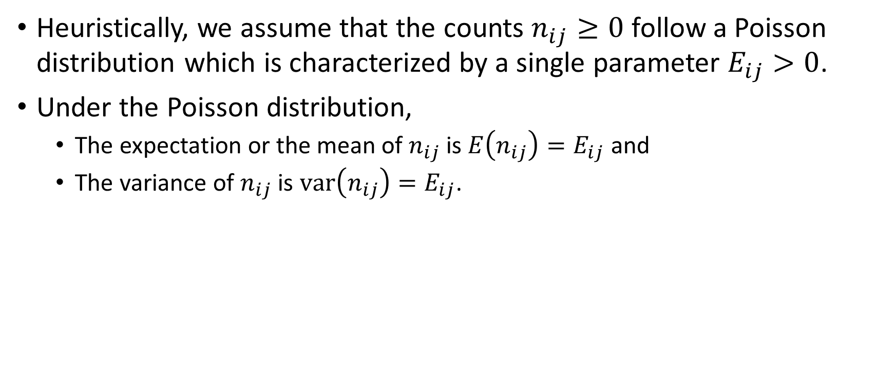
Chi-Squares Test – Poisson Distribution
Heuristically, we assume that the counts $n_{ij}≥0$ follow a Poisson distribution which is characterized by a single parameter $E_{ij}>0$.
Under the Poisson distribution,
The expectation or the mean of $n_{ij}$ is $E\left(n_{ij}\right)=E_{ij}$ and
The variance of $n_{ij}$ is $var\left(n_{ij}\right)=E_{ij}$.

Slide 11
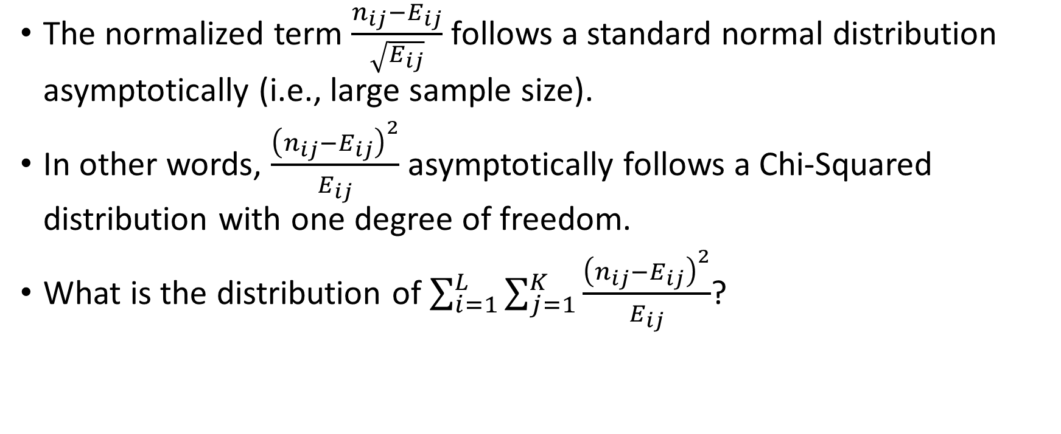
Chi-Squares Test – Poisson Distribution
The normalized term $\frac{n_{ij}−E_{ij}}{\sqrt{E_{ij}}}$ follows a standard normal distribution asymptotically (i.e., large sample size).
In other words, $\frac{{\left(n_{ij}−E_{ij}\right)}^{2}}{E_{ij}}$ asymptotically follows a Chi-Squared distribution with one degree of freedom.
What is the distribution of $\sum_{i=1}^{L}{\sum_{j=1}^{K}{\frac{{\left(n_{ij}−E_{ij}\right)}^{2}}{E_{ij}}}}$?

Slide 12
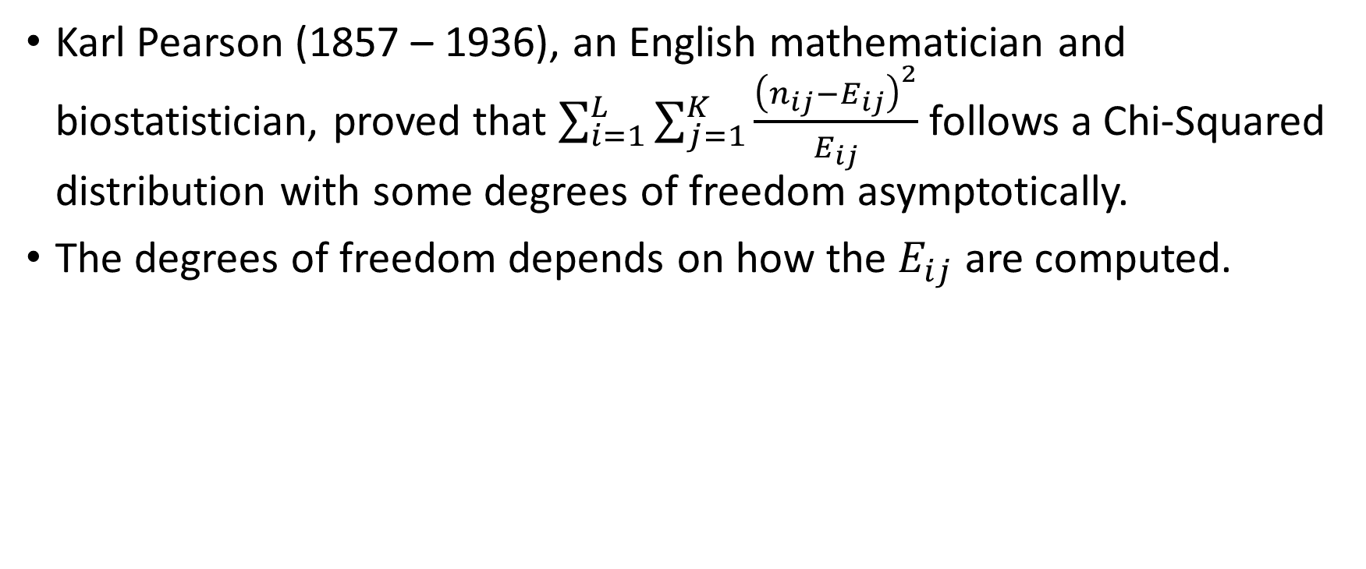
Chi-Squares Test – Karl Pearson
Karl Pearson (1857 – 1936), an English mathematician and biostatistician, proved that $\sum_{i=1}^{L}{\sum_{j=1}^{K}{\frac{{\left(n_{ij}−E_{ij}\right)}^{2}}{E_{ij}}}}$ follows a Chi-Squared distribution with some degrees of freedom asymptotically.
The degrees of freedom depends on how the $E_{ij}$ are computed.

Slide 13
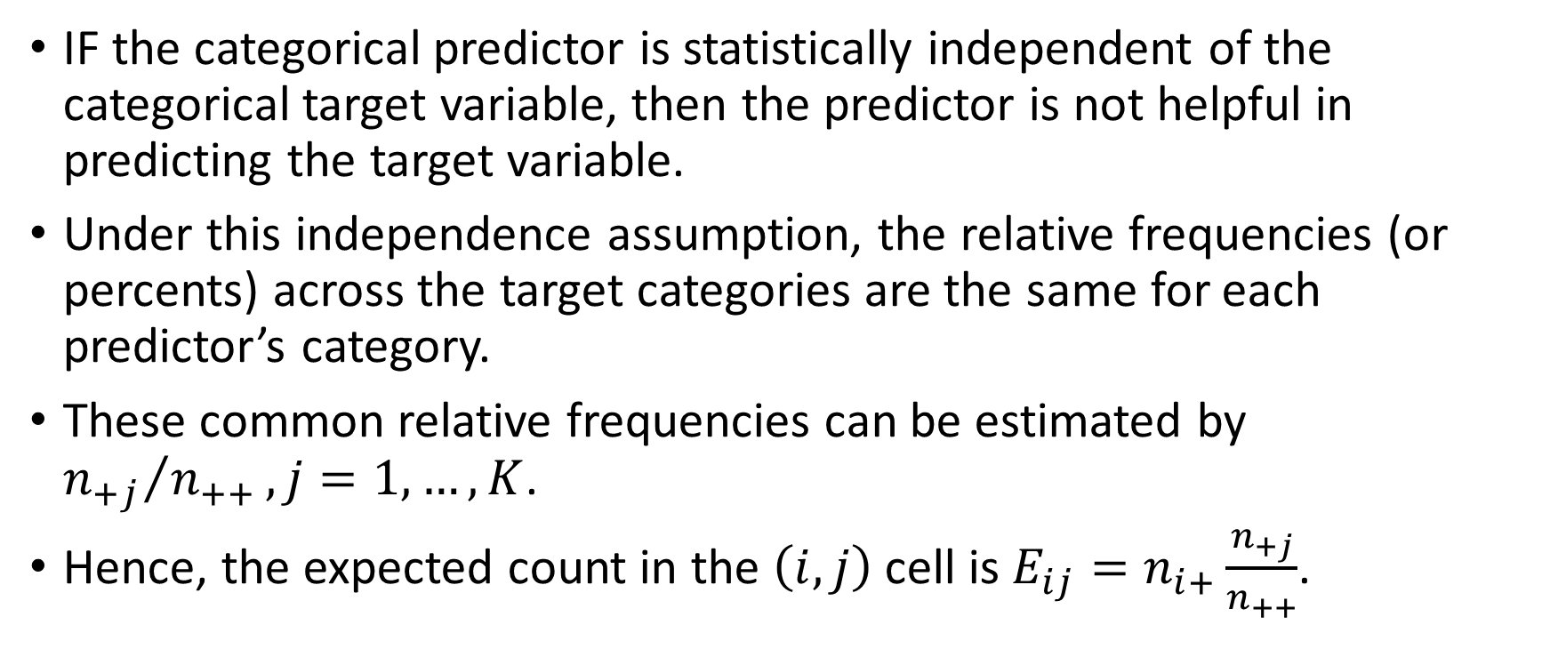
Chi-Squares Test – Independence Assumption
IF the categorical predictor is statistically independent of the categorical target variable, then the predictor is not helpful in predicting the target variable.
Under this independence assumption, the relative frequencies (or percents) across the target categories are the same for each predictor’s category.
These common relative frequencies can be estimated by ${n_{+j}}/{n_{++}},j=1,…,K$.
Hence, the expected count in the $\left(i,j\right)$ cell is $E_{ij}=n_{i+}\frac{n_{+j}}{n_{++}}$.

Slide 14
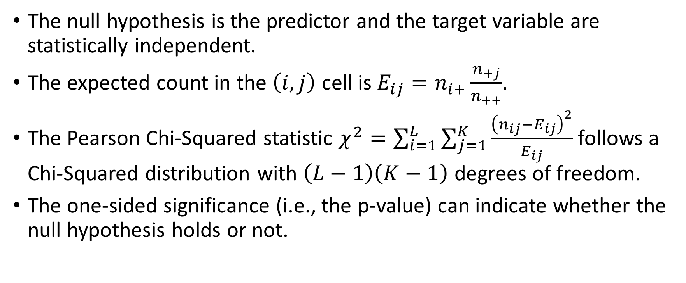
Chi-Squares Test – Independence Assumption
The null hypothesis is the predictor and the target variable are statistically independent.
The expected count in the $\left(i,j\right)$ cell is $E_{ij}=n_{i+}\frac{n_{+j}}{n_{++}}$.
The Pearson Chi-Squared statistic $χ^{2}=\sum_{i=1}^{L}{\sum_{j=1}^{K}{\frac{{\left(n_{ij}−E_{ij}\right)}^{2}}{E_{ij}}}}$ follows a Chi-Squared distribution with $\left(L−1\right)\left(K−1\right)$ degrees of freedom.
The one-sided significance (i.e., the p-value) can indicate whether the null hypothesis holds or not.

Slide 15
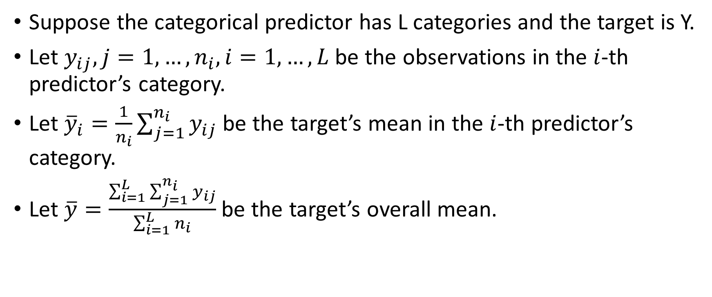
Analysis of Variance (ANOVA) Test
Suppose the categorical predictor has L categories and the target is Y.
Let $y_{ij}, j=1,…, n_{i}, i=1,…, L$ be the observations in the $i$-th predictor’s category.
Let ${\overline{y}}_{i}=\frac{1}{n_{i}}\sum_{j=1}^{n_{i}}{y_{ij}}$ be the target’s mean in the $i$-th predictor’s category.
Let $\overline{y}=\frac{\sum_{i=1}^{L}{\sum_{j=1}^{n_{i}}{y_{ij}}}}{\sum_{i=1}^{L}{n_{i}}}$ be the target’s overall mean.

Slide 16
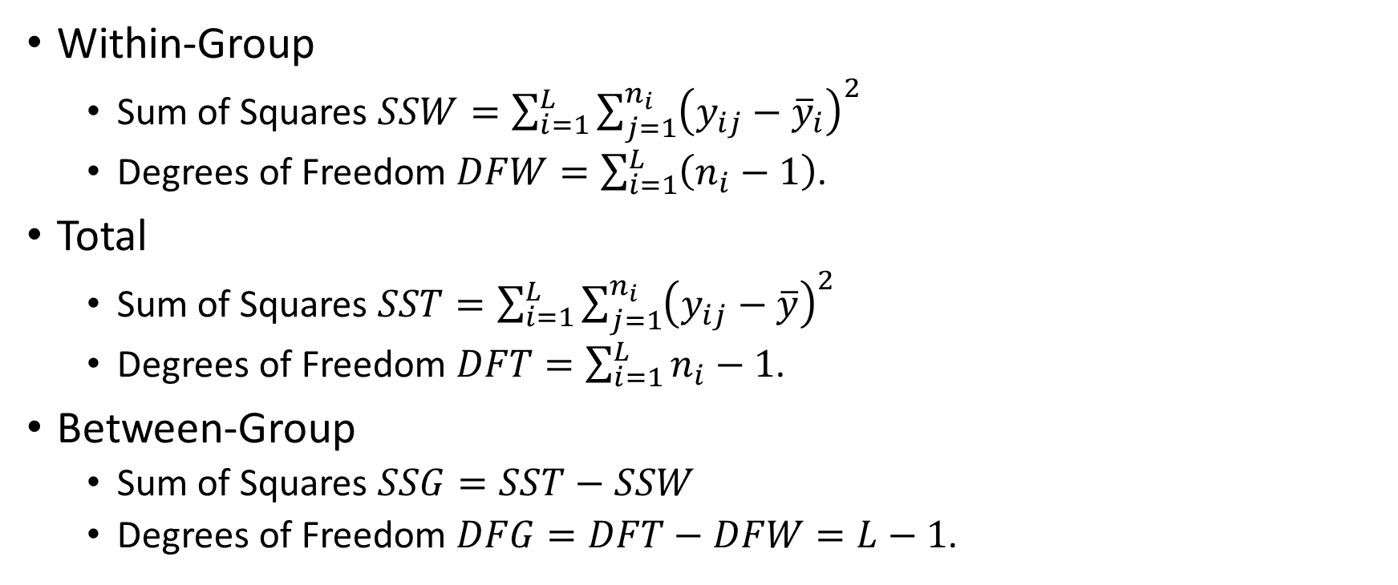
Analysis of Variance (ANOVA) Test
Within-Group
Sum of Squares $SSW=\sum_{i=1}^{L}{\sum_{j=1}^{n_{i}}{{\left(y_{ij}−{\overline{y}}_{i}\right)}^{2}}}$
Degrees of Freedom $DFW=\sum_{i=1}^{L}{\left(n_{i}−1\right)}$.
Total
Sum of Squares $SST=\sum_{i=1}^{L}{\sum_{j=1}^{n_{i}}{{\left(y_{ij}−\overline{y}\right)}^{2}}}$
Degrees of Freedom $DFT=\sum_{i=1}^{L}{n_{i}−1}$.
Between-Group
Sum of Squares $SSG=SST−SSW$
Degrees of Freedom $DFG=DFT−DFW=L−1$.

Slide 17
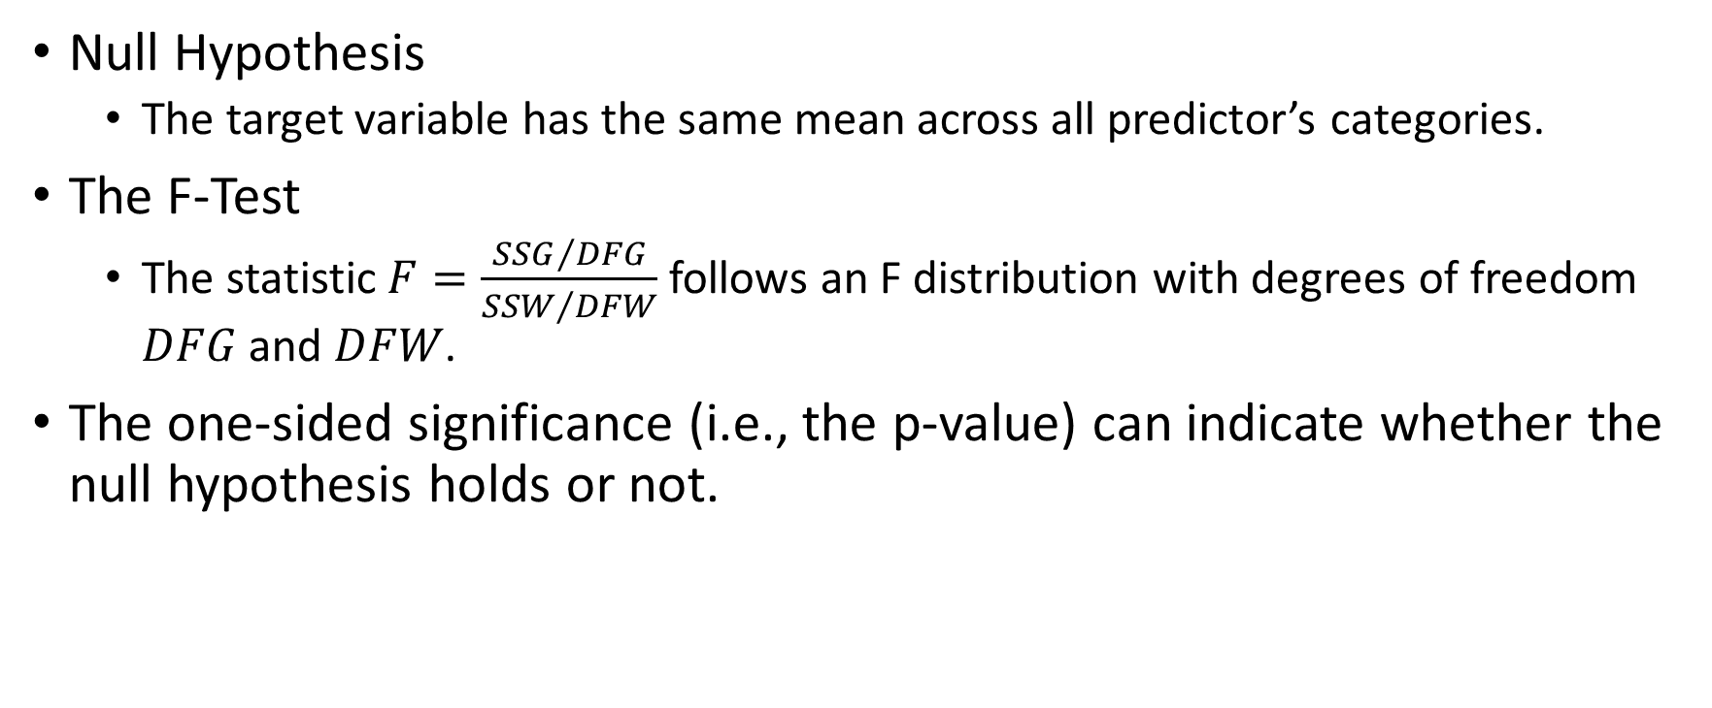
Analysis of Variance (ANOVA) Test
Null Hypothesis
The target variable has the same mean across all predictor’s categories.
The F-Test
The statistic $F=\frac{{SSG}/{DFG}}{{SSW}/{DFW}}$ follows an F distribution with degrees of freedom $DFG$ and $DFW$.
The one-sided significance (i.e., the p-value) can indicate whether the null hypothesis holds or not.

Slide 18
Analysis of Variance (ANOVA) Test: Example
Program file: Week 9 ANOVA.py.
100 observations in simData4ANOVA.csv
Interval target variable is y.
Categorical predictors are x1, x2, and x3. Their categories are:
x1: A, B, C, and D
x2: 1, 2, 3, 4, and 5
x3: True and False

Slide 19
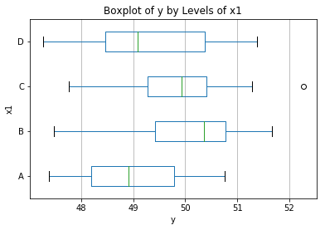
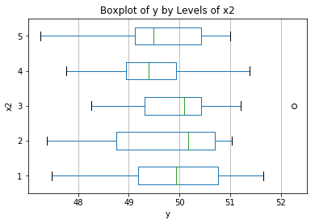
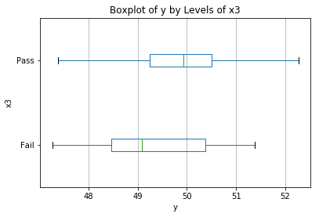
Analysis of Variance (ANOVA) Test

Slide 20
Analysis of Variance (ANOVA) Test
F-test results:
x1: F = 4.629488 and Significance = 0.004556
x2: F = 0.462467 and Significance = 0.763095
x3: F = 4.364200 and Significance = 0.039293
If our tolerance level is at the 5%, i.e., 0.05, then we will conclude that the F statistics are significant for x1 and x3.
The x1 seems to be more predictive for y than x3 based on their significance values.
Our conclusion is the select x1 and x3.

Slide 21
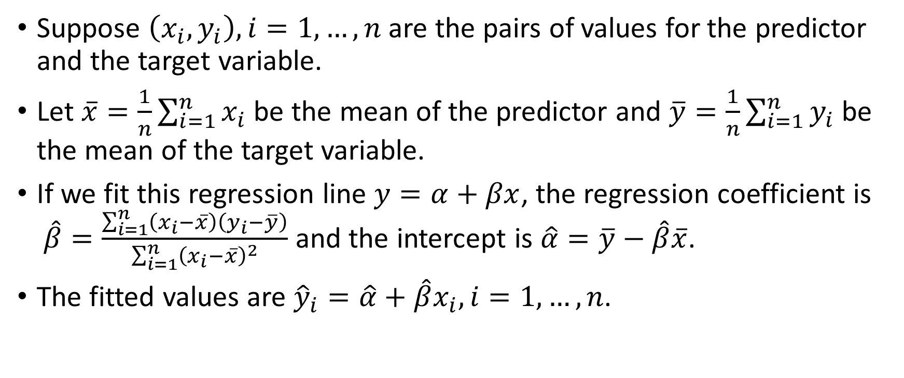
Regression Test
Suppose $\left(x_{i}, y_{i}\right), i=1,…,n$ are the pairs of values for the predictor and the target variable.
Let $\overline{x}=\frac{1}{n}\sum_{i=1}^{n}{x_{i}}$ be the mean of the predictor and $\overline{y}=\frac{1}{n}\sum_{i=1}^{n}{y_{i}}$ be the mean of the target variable.
If we fit this regression line $y=α+βx$, the regression coefficient is $\hat{β}=\frac{\sum_{i=1}^{n}{\left(x_{i}−\overline{x}\right)\left(y_{i}−\overline{y}\right)}}{\sum_{i=1}^{n}{{\left(x_{i}−\overline{x}\right)}^{2}}}$ and the intercept is $\hat{α}=\overline{y}−\hat{β}\overline{x}$.
The fitted values are ${\hat{y}}_{i}=\hat{α}+\hat{β}x_{i},i=1,…,n$.

Slide 22

Regression Test
The residual sum of squares is $RSS=\sum_{i=1}^{n}{{\left(y_{i}−{\hat{y}}_{i}\right)}^{2}}$.
The estimated residual variance is $\hat{σ^{2}}=\frac{\sum_{i=1}^{n}{{\left(y_{i}−{\hat{y}}_{i}\right)}^{2}}}{n−2}$
The standard error of $\hat{β}$is $se\left(\hat{β}\right)=\sqrt{\frac{\hat{σ^{2}}}{\sum_{i=1}^{n}{{\left(x_{i}−\overline{x}\right)}^{2}}}}$.

Slide 23
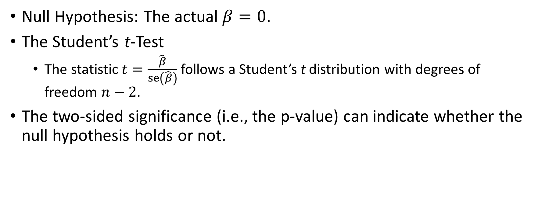
Regression Test
Null Hypothesis: The actual $β=0$.
The Student’s t-Test
The statistic $t=\frac{\hat{β}}{se\left(\hat{β}\right)}$ follows a Student’s t distribution with degrees of freedom $n−2$.
The two-sided significance (i.e., the p-value) can indicate whether the null hypothesis holds or not.

Slide 24
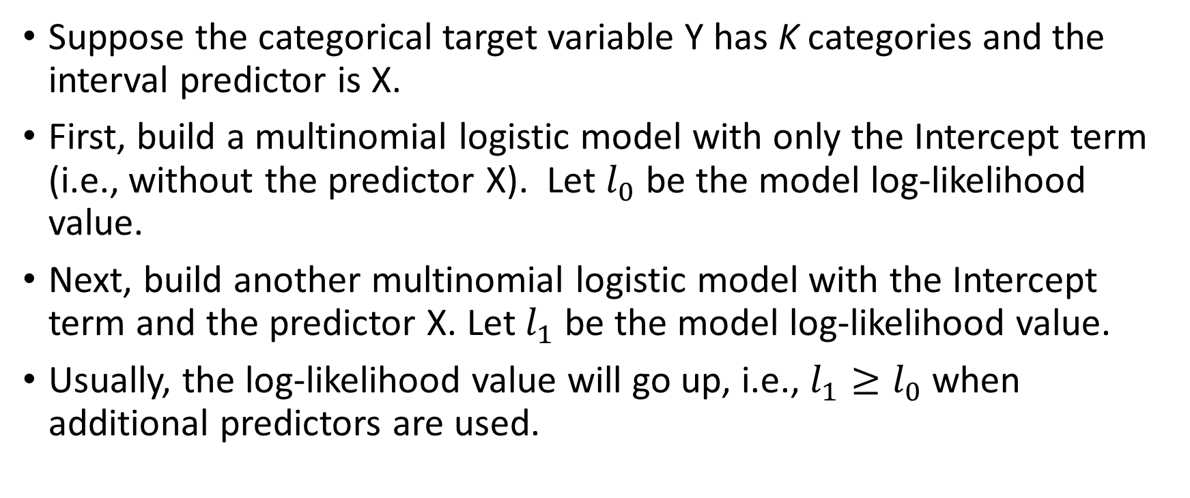
Likelihood Ratio Test
Suppose the categorical target variable Y has K categories and the interval predictor is X.
First, build a multinomial logistic model with only the Intercept term (i.e., without the predictor X). Let $l_{0}$ be the model log-likelihood value.
Next, build another multinomial logistic model with the Intercept term and the predictor X. Let $l_{1}$ be the model log-likelihood value.
Usually, the log-likelihood value will go up, i.e., $l_{1}≥l_{0}$when additional predictors are used.

Slide 25
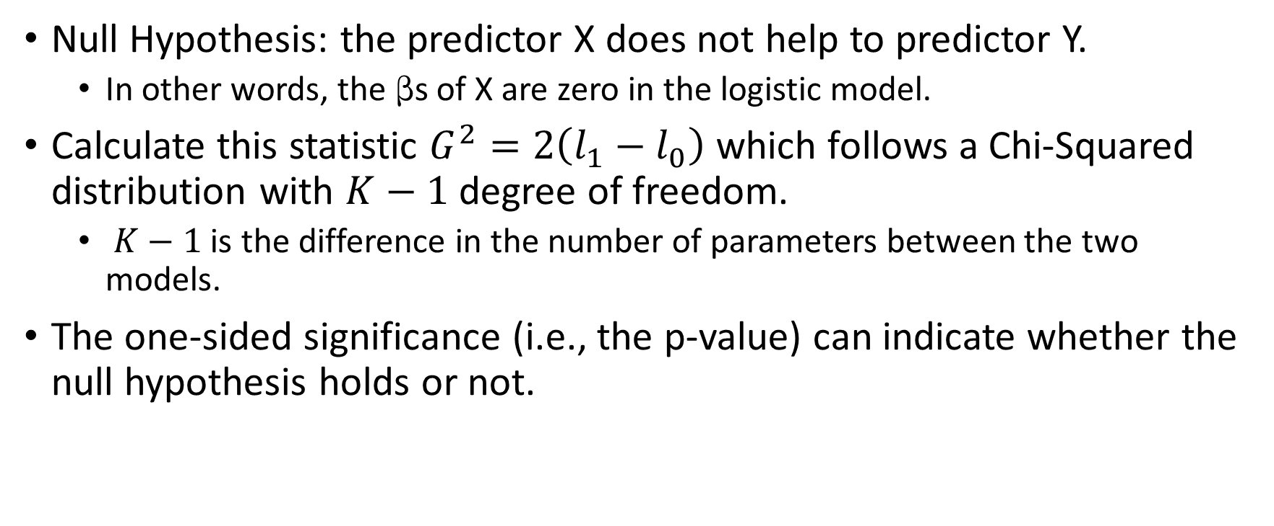
Likelihood Ratio Test
Null Hypothesis: the predictor X does not help to predictor Y.
In other words, the s of X are zero in the logistic model.
Calculate this statistic $G^{2}=2\left(l_{1}−l_{0}\right)$ which follows a Chi-Squared distribution with $K−1$ degree of freedom.
$K−1$ is the difference in the number of parameters between the two models.
The one-sided significance (i.e., the p-value) can indicate whether the null hypothesis holds or not.

Slide 26
Likelihood Ratio Test: Example
Program file: Week 9 LikelihoodRatio.py.
428 observations in the cars.csv
Categorical target variable is Origin.
The categories are Asia, Europe, and USA
Interval predictors are EngineSize, Horsepower, Weight, and Length
Degrees of freedom for the test is 2.

Slide 27
Likelihood Ratio Test: Example
EngineSize
G-Squared statistic = 49.954129, Chi-Squared Significance = 1.4210154e-11
Horsepower
G-Squared statistic = 52.979143, Chi-Squared Significance = 3.1313039e-12
Weight
G-Squared statistic = 32.904073, Chi-Squared Significance = 7.1609624e-08
Length
G-Squared statistic = 68.269620, Chi-Squared Significance = 1.4977537e-15

Slide 28
Likelihood Ratio Test: Example
Consider the features in the ascending Chi-Squared significances
Length
G-Squared statistic = 68.269620, Chi-Squared Significance = 1.4977537e-15
Horsepower
G-Squared statistic = 52.979143, Chi-Squared Significance = 3.1313039e-12
EngineSize
G-Squared statistic = 49.954129, Chi-Squared Significance = 1.4210154e-11
Weight
G-Squared statistic = 32.904073, Chi-Squared Significance = 7.1609624e-08

Slide 29
Feature Selection – “Collinearity”
A common response is to include some data-healthy features that are easy for interpretations and drop others
Another response is to combine the features
When there are no obvious champions and the predictors are compatible in the units of measurement, then consider combining them linearly using the Principal Component Analysis.

Slide 30
Principal Component: Overview
A dimension-reduction tool that is particularly useful when there are a substantial number of correlated features.
Instead of requiring us to drop some features, it transforms the set of correlated features to another set of uncorrelated features in descending level of accountability of the total variance.
Originated by Pearson (1901) and later developed by Hotelling (1933).
Pearson, Karl (1901). “On Lines and Planes of Closest Fit to Systems of Points in Space.” Philosophical Magazine, 6, 559–572.
Hotelling, Harold (1933). “Analysis of a Complex of Statistical Variables into Principal Components.” Journal of Educational Psychology, 24, 417–441 and 498–520.

Slide 31
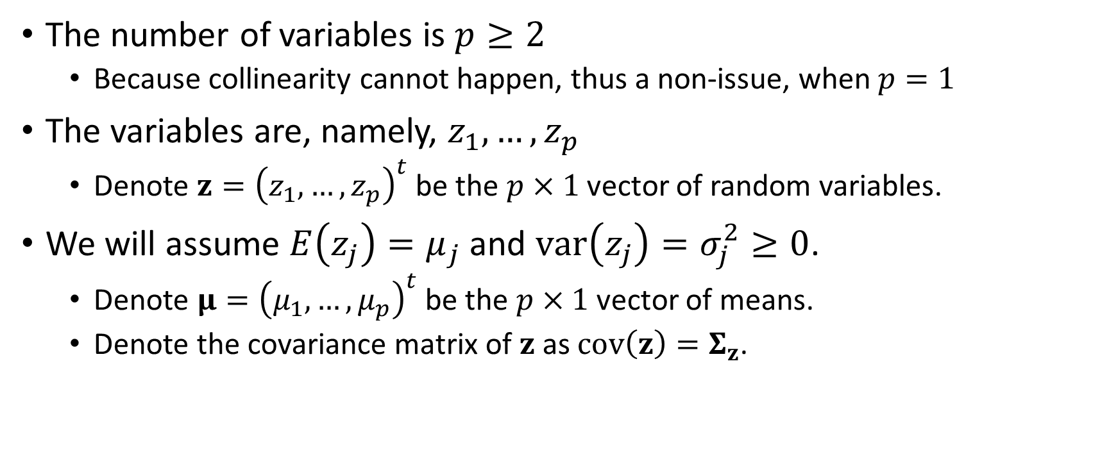
Principal Component: The Training Data
The number of variables is $p≥2$
Because collinearity cannot happen, thus a non-issue, when $p=1$
The variables are, namely, $z_{1},…,z_{p}$
Denote $z={\left(z_{1},…,z_{p}\right)}^{t}$ be the $p×1$ vector of random variables.
We will assume $E\left(z_{j}\right)=μ_{j}$ and $var\left(z_{j}\right)=σ_{j}^{2}≥0$.
Denote $μ={\left(μ_{1},…,μ_{p}\right)}^{t}$ be the $p×1$ vector of means.
Denote the covariance matrix of $z$ as $cov\left(z\right)=Σ_{z}$.

Slide 32
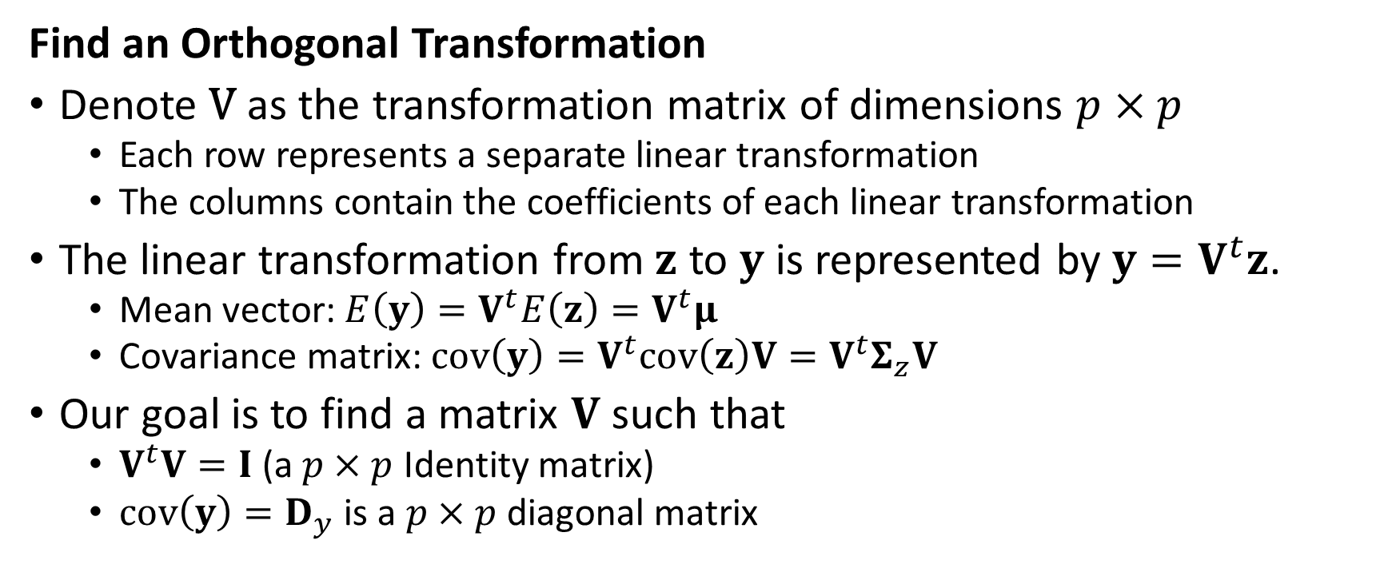
Principal Component: Transformation
Find an Orthogonal Transformation
Denote V as the transformation matrix of dimensions $p×p$
Each row represents a separate linear transformation
The columns contain the coefficients of each linear transformation
The linear transformation from $z$ to $y$ is represented by $y=V^{t}z$.
Mean vector: $E\left(y\right)=V^{t}E\left(z\right)=V^{t}μ$
Covariance matrix: $cov\left(y\right)=V^{t}cov\left(z\right)V=V^{t}Σ_{z}V$
Our goal is to find a matrix $V$ such that
$V^{t}V=I$ (a $p×p$ Identity matrix)
$cov\left(y\right)=D_{y}$ is a $p×p$ diagonal matrix

Slide 33
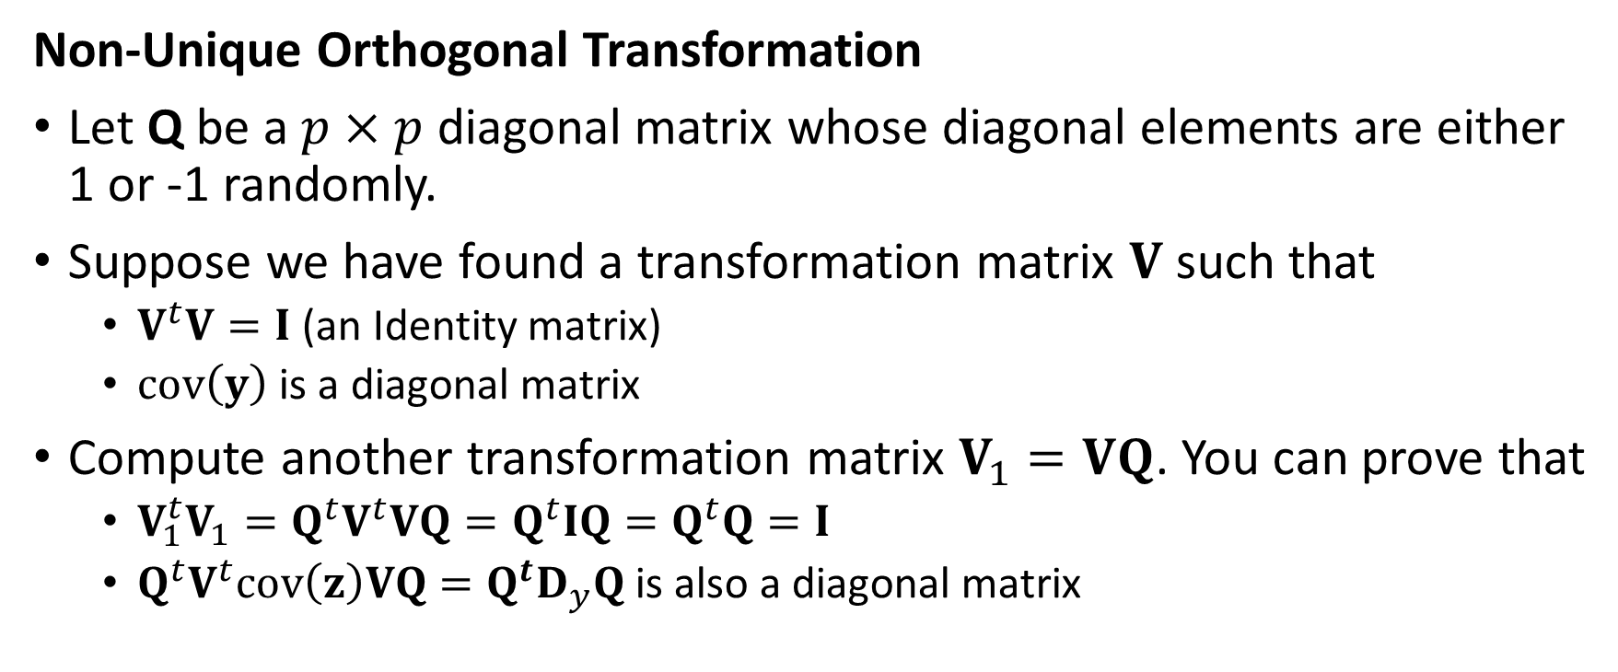
Principal Component: Transformation
Non-Unique Orthogonal Transformation
Let Q be a $p×p$ diagonal matrix whose diagonal elements are either 1 or -1 randomly.
Suppose we have found a transformation matrix $V$ such that
$V^{t}V=I$ (an Identity matrix)
$cov\left(y\right)$ is a diagonal matrix
Compute another transformation matrix $V_{1}=VQ$. You can prove that
$V_{1}^{t}V_{1}=Q^{t}V^{t}VQ=Q^{t}IQ=Q^{t}Q=I$
${Q^{t}V}^{t}cov\left(z\right)VQ=Q^{t}D_{y}Q$ is also a diagonal matrix

Slide 34
Principal Component: Transformation
Find the Unique Orthogonal Transformation
Hotelling (1933) derived the “principal components” solution.
Harold Hotelling (1895 – 1973).
In essence, we want a solution such that the variance of the j^{th} principal component is maximized subject to the constraint that the transformation is orthonormalized.

Slide 35
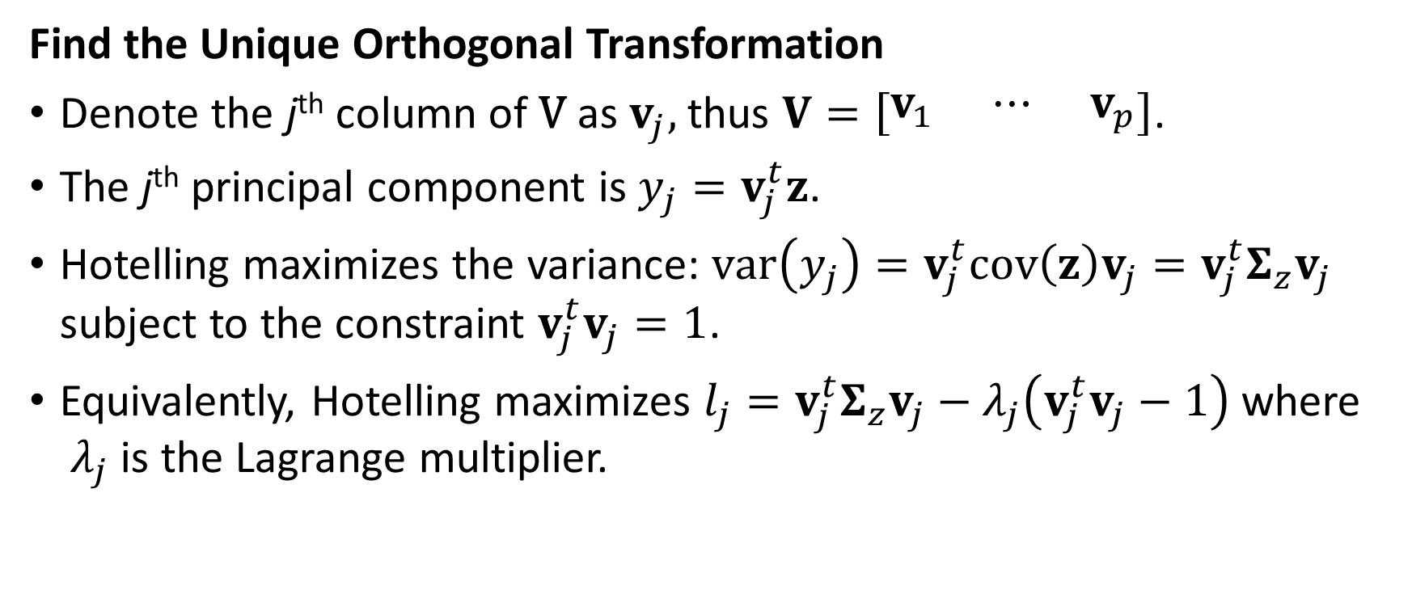
Principal Component: Transformation
Find the Unique Orthogonal Transformation
Denote the j^{th} column of V as $v_{j},$ thus $V=\left[\begin{matrix}v_{1} & ⋯ & v_{p}\end{matrix}\right]$.
The j^{th} principal component is $y_{j}=v_{j}^{t}z$.
Hotelling maximizes the variance: $var\left(y_{j}\right)=v_{j}^{t}cov\left(z\right)v_{j}=v_{j}^{t}Σ_{z}v_{j}$ subject to the constraint $v_{j}^{t}v_{j}=1$.
Equivalently, Hotelling maximizes $l_{j}=v_{j}^{t}Σ_{z}v_{j}−λ_{j}\left(v_{j}^{t}v_{j}−1\right)$ where ${ λ}_{j}$ is the Lagrange multiplier.

Slide 36
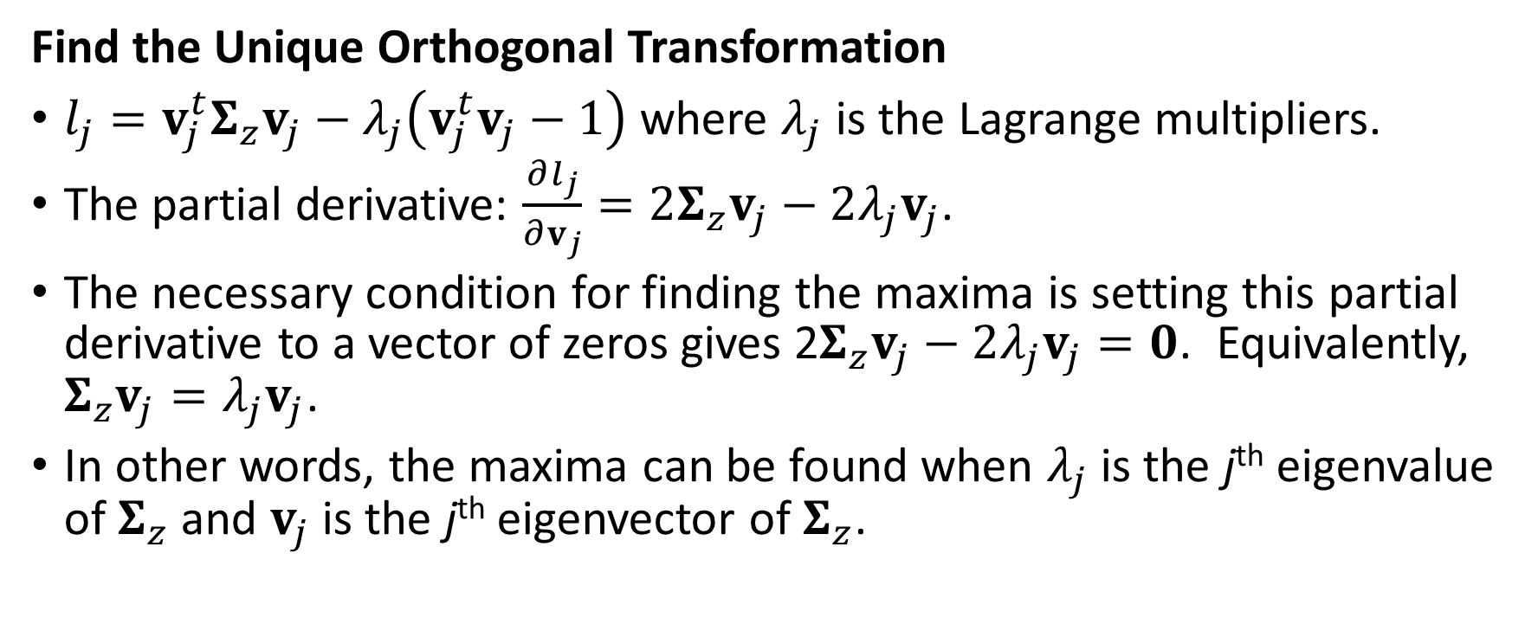
Principal Component: Transformation
Find the Unique Orthogonal Transformation
$l_{j}=v_{j}^{t}Σ_{z}v_{j}−λ_{j}\left(v_{j}^{t}v_{j}−1\right)$ where $λ_{j}$ is the Lagrange multipliers.
The partial derivative: $\frac{∂l_{j}}{∂v_{j}}=2Σ_{z}v_{j}−2λ_{j}v_{j}$.
The necessary condition for finding the maxima is setting this partial derivative to a vector of zeros gives 2$Σ_{z}v_{j}−2λ_{j}v_{j}=0$. Equivalently, $Σ_{z}v_{j}=λ_{j}v_{j}$.
In other words, the maxima can be found when $λ_{j}$ is the j^{th} eigenvalue of $Σ_{z}$ and $v_{j}$ is the j^{th} eigenvector of $Σ_{z}$.

Slide 37
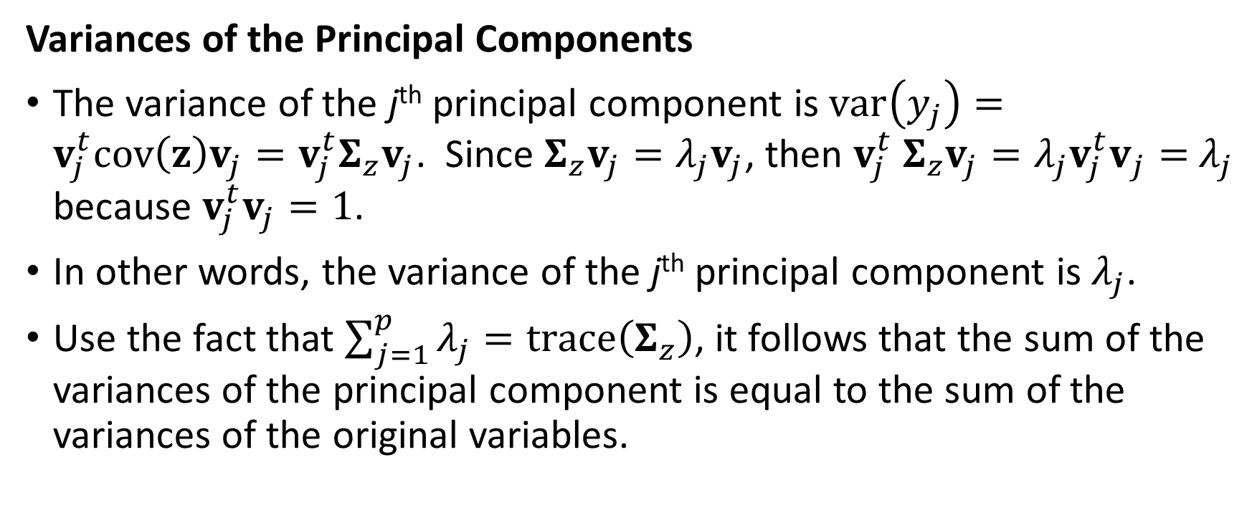
Principal Component: Variances
Variances of the Principal Components
The variance of the j^{th} principal component is $var\left(y_{j}\right)=v_{j}^{t}cov\left(z\right)v_{j}=v_{j}^{t}Σ_{z}v_{j}$. Since $Σ_{z}v_{j}=λ_{j}v_{j}$, then $v_{j}^{t} Σ_{z}v_{j}=λ_{j}{v_{j}^{t}v}_{j}=$ $λ_{j}$ because $v_{j}^{t}v_{j}=1$.
In other words, the variance of the j^{th} principal component is $λ_{j}$.
Use the fact that $\sum_{j=1}^{p}{λ_{j}}=trace\left(Σ_{z}\right)$, it follows that the sum of the variances of the principal component is equal to the sum of the variances of the original variables.

Slide 38
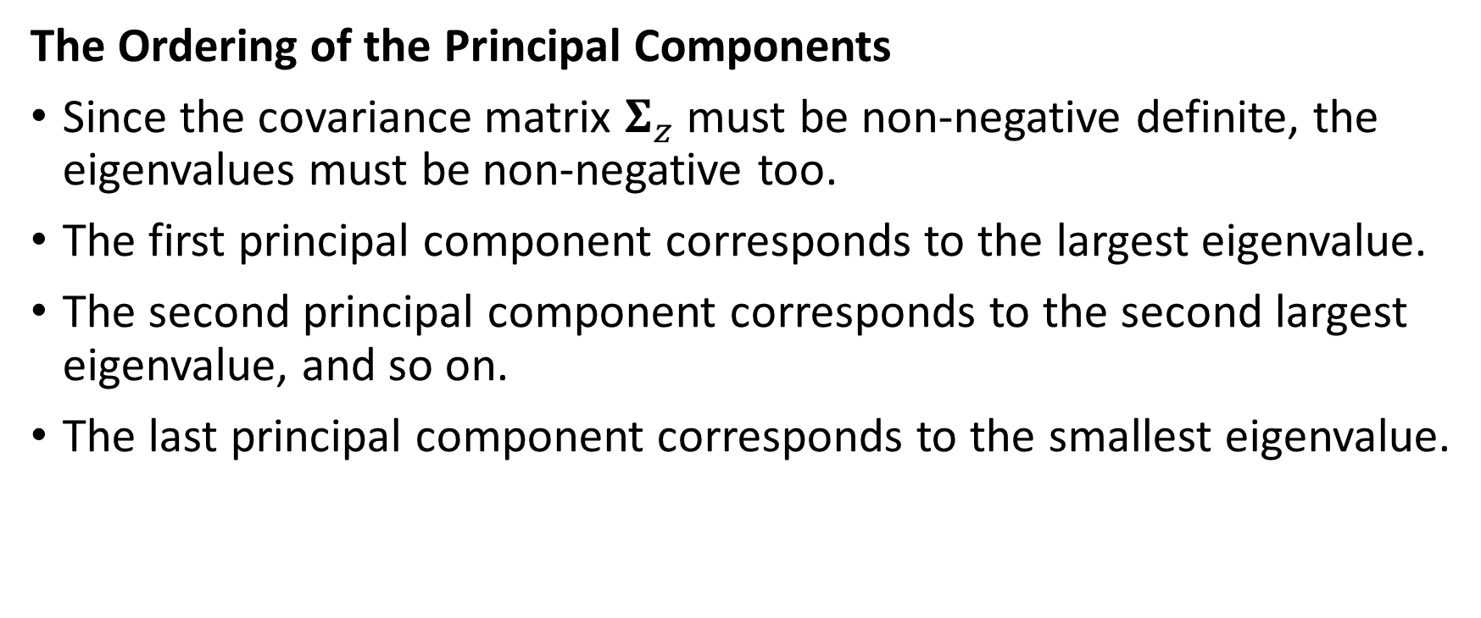
Principal Component: Ordering
The Ordering of the Principal Components
Since the covariance matrix $Σ_{z}$ must be non-negative definite, the eigenvalues must be non-negative too.
The first principal component corresponds to the largest eigenvalue.
The second principal component corresponds to the second largest eigenvalue, and so on.
The last principal component corresponds to the smallest eigenvalue.

Slide 39
Principal Component: Example Week 9 Simulation PrinComp.py
numpy.random.seed(1017)
z0 = numpy.random.normal(loc = 0.0, scale = 1.0, size = 5000)
z1 = numpy.random.uniform(low = -numpy.sqrt(3), high = numpy.sqrt(3), size = 5000)
z2 = (z0 + z1) / numpy.sqrt(2)
z3 = (z0 - z1) / numpy.sqrt(2)
z = pandas.DataFrame()
z['z0'] = z0
z['z1'] = z1
z['z2'] = z2
z['z3'] = z3

Slide 40
Principal Component: Example
print('Descriptive Statistics: \n', z.describe())
# Calculate the Correlations among the variables
zCorrelation = z.corr(method = 'pearson', min_periods = 1)
print('Empirical Correlation: \n', zCorrelation)
Descriptive Statistics
 | z0 | z1 | z2 | z3
count | 5000 | 5000 | 5000 | 5000
mean | -0.022804 | -0.002476 | -0.017876 | -0.014374
std | 1.00853 | 0.994521 | 1.005456 | 0.997629
min | -3.927028 | -1.731972 | -3.21066 | -3.374742
25% | -0.680362 | -0.864244 | -0.731999 | -0.717231
50% | -0.033509 | -0.014367 | -0.021156 | -0.032936
75% | 0.634985 | 0.843666 | 0.670243 | 0.690334
max | 3.995817 | 1.731765 | 3.052465 | 2.992758
Empirical Correlation:
 | z0 | z1 | z2 | z3
z0 | 1 | 0.007816 | 0.714735 | 0.709324
z1 | 0.007816 | 1 | 0.70496 | -0.699317
z2 | 0.714735 | 0.70496 | 1 | 0.013988
z3 | 0.709324 | -0.699317 | 0.013988 | 1

Slide 41
Principal Component: Example
# Eigenvalue decomposition
evals, evecs = numpy.linalg.eigh(zCorrelation)
Index | Eigenvalues
0 | -1.11528802153434E-15
1 | 1.11528802138873E-15
2 | 1.98397629940875E+00
3 | 2.01602370059124E+00
Eigenvectors (as columns)
0 | 1 | 2 | 3
7.08757310538143E-01 | 3.38121090123292E-02 | 1.76267215000527E-01 | -6.82238730180890E-01
3.08260123592772E-02 | -7.03943128942986E-01 | -6.86328160951320E-01 | -1.80187357106876E-01
-5.21676376848988E-01 | 4.79400053483425E-01 | -3.55008460802516E-01 | -6.09916665878568E-01
-4.73884574087905E-01 | -5.22968833888009E-01 | 6.09797111472138E-01 | -3.60672277924953E-01
Check
The Trace of the Empirical Correlation is 4
The Sum of all 4 Eigenvalues is 3.99999999999999

Slide 42
Principal Component: Example
import sklearn.decomposition as decomposition
myPCA = decomposition.PCA(n_components = 4, svd_solver = 'full')
myPCA.fit(z)
print("Mean: \n", myPCA.mean_)
print('Explained Variance: \n', myPCA.explained_variance_)
print('Explained Variance Ratio: \n', myPCA.explained_variance_ratio_)
print('Principal Components: \n', myPCA.components_)

Slide 43
Principal Component: Example
Mean:
[-0.02280405 -0.00247609 -0.01787576 -0.01437404]
Explained Variance:
[2.03834744e+00 1.97405981e+00 2.53888532e-31 2.31017544e-32]
Mean is per-feature empirical mean, estimated from the training set.
Descriptive Statistics
 | z0 | z1 | z2 | z3
count | 5000 | 5000 | 5000 | 5000
mean | -0.022804 | -0.002476 | -0.017876 | -0.014374
Index | Eigenvalues
0 | -1.11528802153434E-15
1 | 1.11528802138873E-15
2 | 1.98397629940875E+00
3 | 2.01602370059124E+00
Explained Variance is the amount of variance explained by each of the selected components. In other words, it is the eigenvalue

Slide 44
Principal Component: Example
Explained Variance Ratio:
[5.08011104e-01 4.91988896e-01 6.32758631e-32 5.75757968e-33]
Principal Components:
[[ 0.68428497 0.17819676 0.60986668 0.3578584 ]
[-0.17819676 0.68428497 0.3578584 -0.60986668]
[-0.67025603 -0.22529283 0.63324867 0.31463649]
[-0.22529283 0.67025603 -0.31463649 0.63324867]]
Explained Variance Ratio is the Explained Variance divided by the sum of the eigenvalues.
These are the Principal Components. Each column contains the coefficients for the linear transformation. The order of the columns corresponds to that of the Explained Variance.

Slide 45
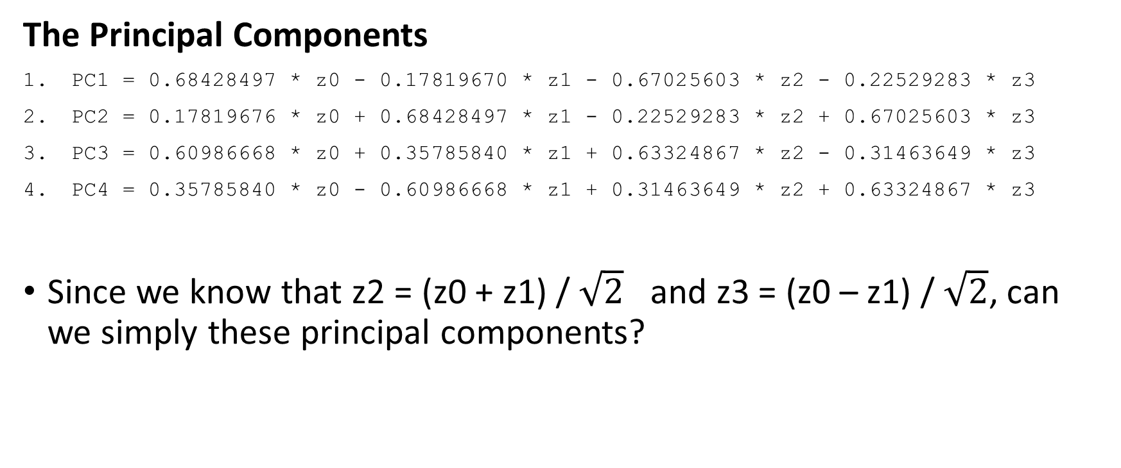
Principal Component: Example
The Principal Components
PC1 = 0.68428497 * z0 - 0.17819670 * z1 - 0.67025603 * z2 - 0.22529283 * z3
PC2 = 0.17819676 * z0 + 0.68428497 * z1 - 0.22529283 * z2 + 0.67025603 * z3
PC3 = 0.60986668 * z0 + 0.35785840 * z1 + 0.63324867 * z2 - 0.31463649 * z3
PC4 = 0.35785840 * z0 - 0.60986668 * z1 + 0.31463649 * z2 + 0.63324867 * z3
Since we know that z2 = (z0 + z1) / $\sqrt{2}$ and z3 = (z0 – z1) / $\sqrt{2}$, can we simply these principal components?

Slide 46
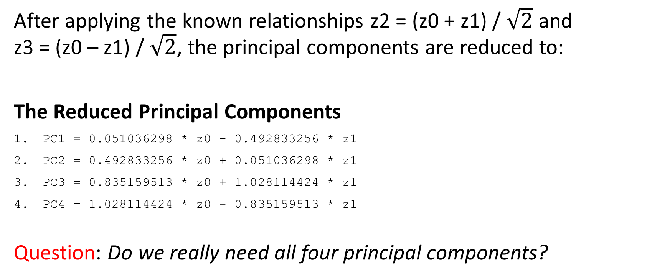
Principal Component: Example
After applying the known relationships z2 = (z0 + z1) / $\sqrt{2}$ and z3 = (z0 – z1) / $\sqrt{2}$, the principal components are reduced to:
The Reduced Principal Components
PC1 = 0.051036298 * z0 - 0.492833256 * z1
PC2 = 0.492833256 * z0 + 0.051036298 * z1
PC3 = 0.835159513 * z0 + 1.028114424 * z1
PC4 = 1.028114424 * z0 - 0.835159513 * z1
Question: Do we really need all four principal components?
Remarks:
PC1 is dominated by z1
PC2 is dominated by z0
PC3 is practically the sum of z0 and z1
PC4 is practically the difference of z0 and z1

Slide 47
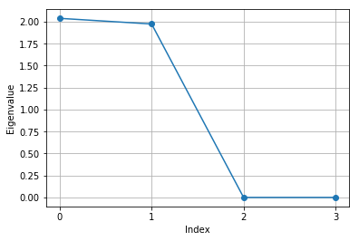
Principal Component: Number of Components
Question: Do we really need all four principal components?
Task: Plot the eigenvalues (or the Explained Variance) against the index. Count the number of eigenvalues which are greater than one.
Observation: It seems to me that it is sufficient to take the first two principal components.

Slide 48
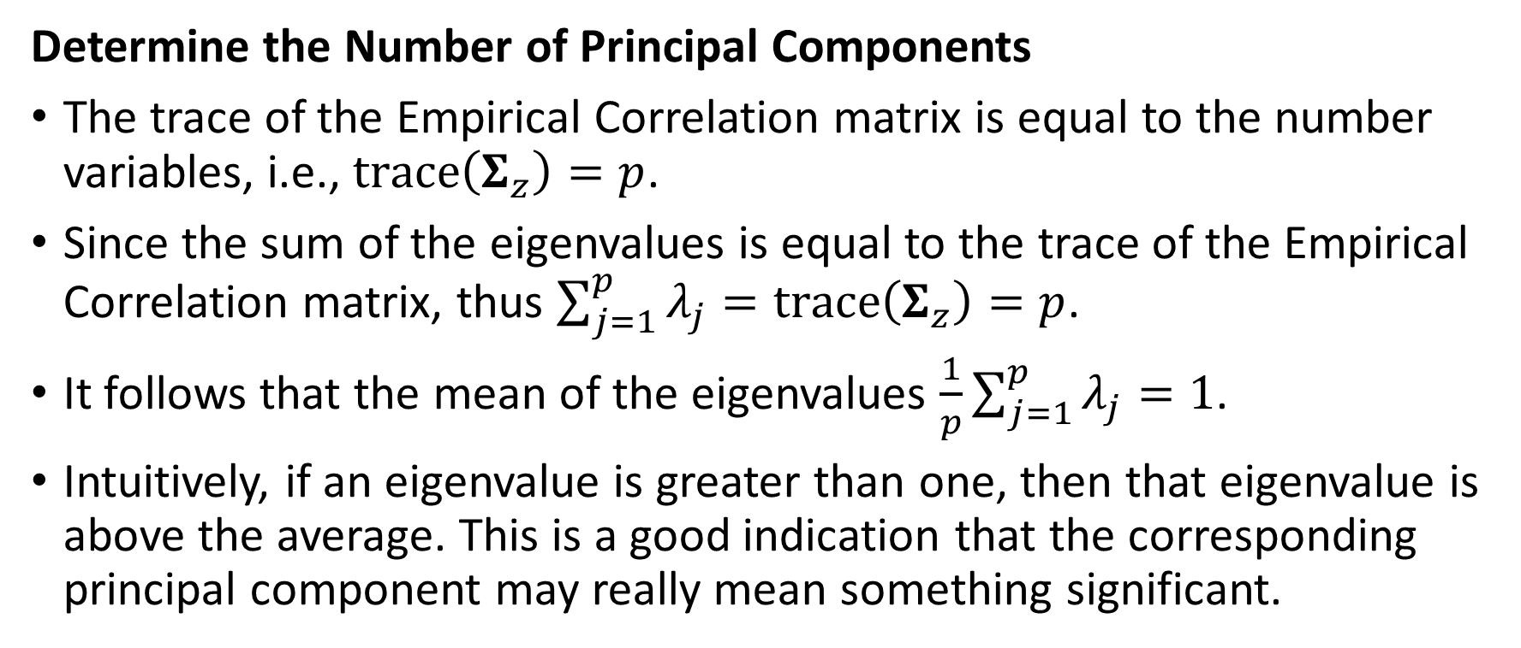
Principal Component: Rationale
Determine the Number of Principal Components
The trace of the Empirical Correlation matrix is equal to the number variables, i.e., $trace\left(Σ_{z}\right)=p$.
Since the sum of the eigenvalues is equal to the trace of the Empirical Correlation matrix, thus $\sum_{j=1}^{p}{λ_{j}}=trace\left(Σ_{z}\right)=p$.
It follows that the mean of the eigenvalues $\frac{1}{p}\sum_{j=1}^{p}{λ_{j}}=1$.
Intuitively, if an eigenvalue is greater than one, then that eigenvalue is above the average. This is a good indication that the corresponding principal component may really mean something significant.

Slide 49
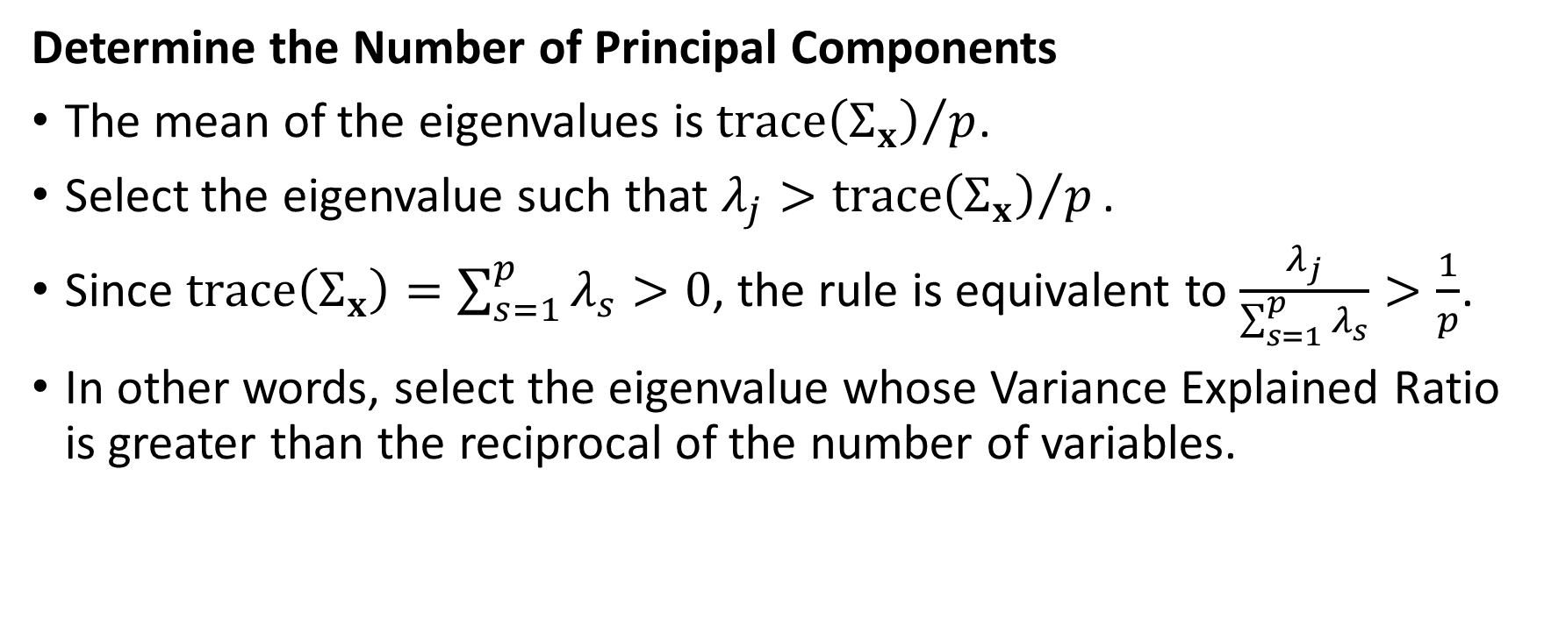
Principal Component: The General Case
Determine the Number of Principal Components
The mean of the eigenvalues is ${trace\left(Σ_{x}\right)}/p$.
Select the eigenvalue such that $λ_{j}>{trace\left(Σ_{x}\right)}/p\text{.}$
Since $trace\left(Σ_{x}\right)=\sum_{s=1}^{p}{λ_{s}}>0$, the rule is equivalent to $\frac{λ_{j}}{\sum_{s=1}^{p}{λ_{s}}}>\frac{1}{p}$.
In other words, select the eigenvalue whose Variance Explained Ratio is greater than the reciprocal of the number of variables.

Slide 50
Principal Component: Example
U.S. Treasury Rate
The daily market rates of U.S. Treasury products
Bill: Bill_1Month, Bill_3Month, Bill_6Month, Bill_1Year
Note: Note_2Year, Note_3Year, Note_5Year, Note_7Year, Note_10Year
Bond: Bond_20Year, Bond_30Year
From January 2, 2018 to October 12, 2018
It is commonly known that these rates are highly correlated.
After all, they are all some kind of interest rates!
Week 9 TreasureRate PrinComp.py

Slide 51
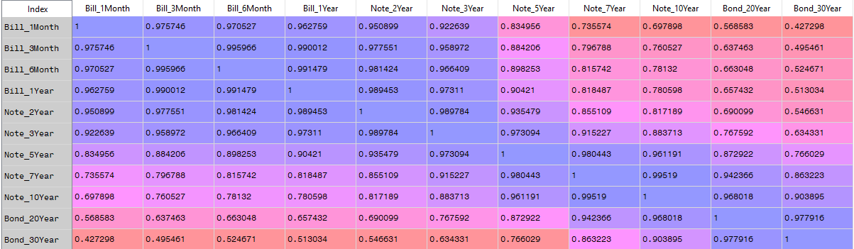
Principal Component: Correlations

Slide 52
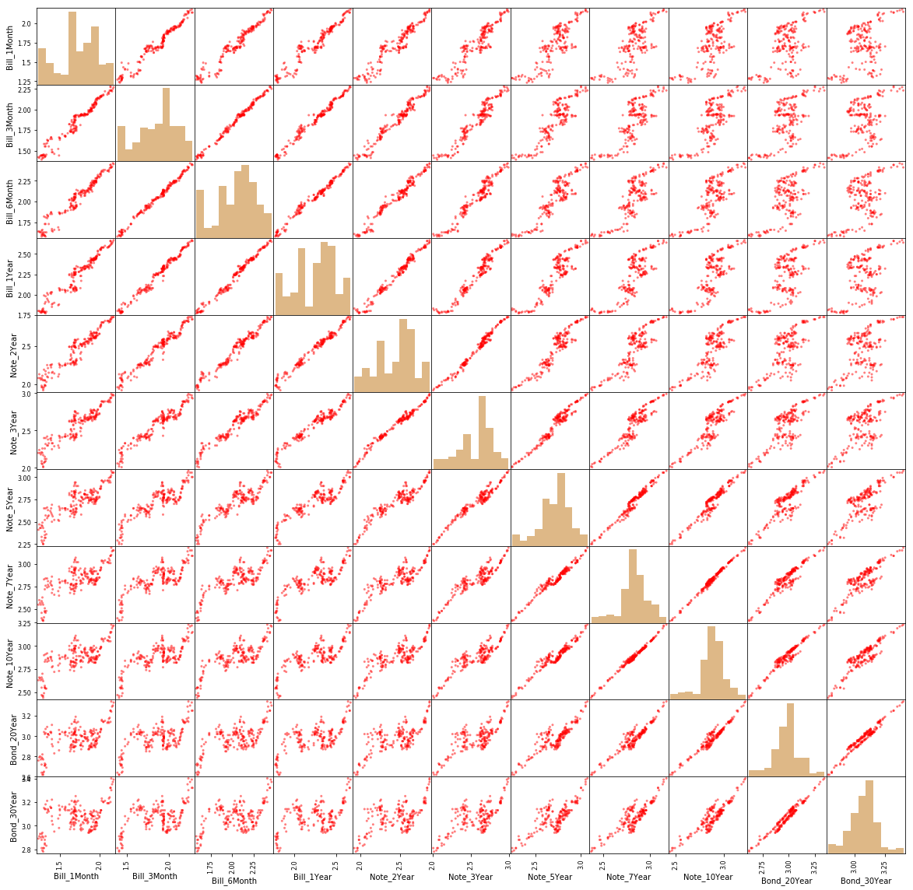
Principal Component: Scatterplot Matrix
Treasury Bills
Treasury Notes
Treasury Bonds

Slide 53
Principal Component: Explained Variance
The Explained Variances (i.e., the eigenvalues) are:
[3.92300471e-01 3.26343809e-02 3.48702900e-03 1.70994716e-03 6.16602704e-04 2.88972839e-04 1.73742209e-04 7.43246504e-05 5.76629315e-05 2.65093244e-05 1.35176301e-05]
The Cumulative Sum of Explained Variances Ratios are:
[0.90940145 0.98505202 0.99313538 0.99709926 0.99852862 0.99919849 0.99960125 0.99977354 0.99990721 0.99996866 1.]

Slide 54
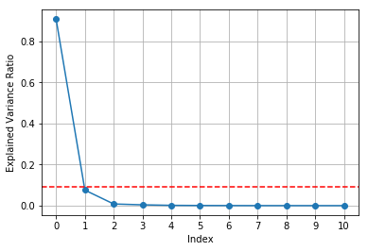
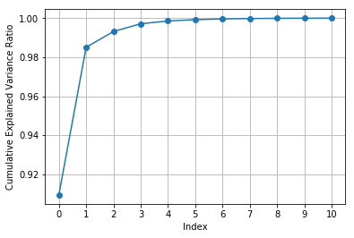
Principal Component: Explained Variance
The first two principal components account for 98.5052% of the total variance.

Slide 55
Principal Component: Output
Principal Components:
[[-0.37599879 -0.36544955 -0.35806895 -0.38303809 -0.38110511 -0.34946336 -0.25332163 -0.21429364 -0.19488573 -0.15112312 -0.10891275]
[-0.33990047 -0.21283347 -0.16421804 -0.17332388 -0.0871544 0.07172233 0.25287146 0.37322721 0.39827098 0.44869461 0.45412742]
[-0.54555264 -0.17562539 -0.14895402 0.13335068 0.38184286 0.35583851 0.26948598 0.12829182 -0.01358448 -0.29854332 -0.42513431]
[ 0.64847682 -0.32984032 -0.3732991 -0.37710033 0.06228087 0.15122652 0.24839495 0.17416294 0.10974229 -0.15182047 -0.18775605]
[-0.11157337 0.45496533 0.31191377 -0.39422355 -0.44886083 -0.00733055 0.20251509 0.30369882 0.20702415 -0.22134986 -0.31815979]
[-0.09869647 0.08702242 0.28785087 -0.70462354 0.51618171 0.12559873 -0.07358023 -0.23073278 -0.13917482 0.02870643 0.20559597]
[ 0.04561006 -0.67803599 0.7050794 0.0620273 -0.13850664 -0.01719013 0.07639651 0.04603344 0.00143777 -0.09784948 -0.0138163 ]
[ 0.01511843 -0.07917128 0.03122173 -0.06334289 -0.10985452 0.4978599 -0.62440758 -0.01827345 0.26020003 0.36813674 -0.36760885]
[-0.01091991 0.02811335 -0.06560603 0.01786907 -0.4049869 0.669584 0.06638049 -0.19564277 -0.2288928 -0.31087016 0.43634296]
[-0.00442982 -0.01188238 -0.02597774 0.04144692 0.18464694 -0.09469427 -0.49958868 0.33524534 0.3753317 -0.5960177 0.31031552]
[-0.01747532 -0.00329101 -0.0063621 0.03808143 -0.01412576 -0.04407112 0.20351549 -0.68512703 0.68408429 -0.12985 -0.0200341 ]]
The columns are the principal components in descending order of explained variances.
The rows are the input features

Slide 56
Principal Component: First Two Components
The first principal component is dominated by the Treasury Bills
The second principal component is dominated by the 5-Year Note, 2-Year Note, 1-Year Bill, and 1-Month Bill
 | PC1 | PC2
Bill_1Month | -0.38 | -0.37
Bill_3Month | -0.34 | -0.21
Bill_6Month | -0.55 | -0.18
Bill_1Year | 0.65 | -0.33
Note_2Year | -0.11 | 0.45
Note_3Year | -0.10 | 0.09
Note_5Year | 0.05 | -0.68
Note_7Year | 0.02 | -0.08
Note_10Year | -0.01 | 0.03
Bond_20Year | 0.00 | -0.01
Bond_30Year | -0.02 | 0.00

Slide 57
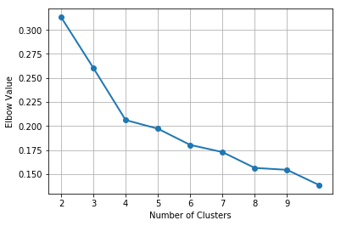
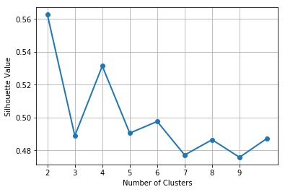
Principal Component: Clustering
Using the first two principal components, identify clusters.
The Elbow chart and the Silhouette chart indicate that there are four clusters.

Slide 58
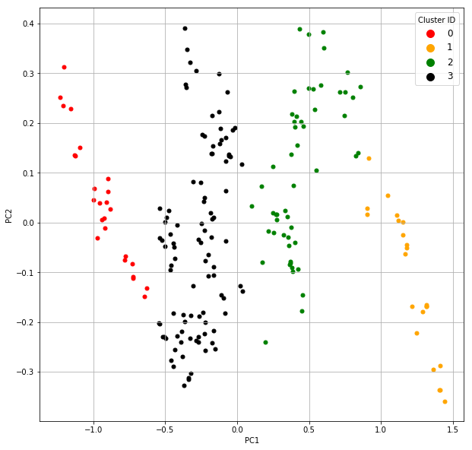
Principal Component: Clustering
Cluster 0
Low PC1
PC2 inversely proportional to PC1
Cluster 1
Lower mid-range PC1
Cluster 2
Upper mid-range PC1
PC2 slightly proportional to PC1
Cluster 3
High PC1
PC2 inversely proportional to PC1

Slide 59
Principal Components: Summary
Principal components are linear combinations of the features
Principal components maximize the variances of the linear combinations.
Principal components are calculated by decomposing a covariance matrix into its eigenvalues and the corresponding eigenvectors.
The eigenvectors are the coefficients of the linear combinations
The eigenvalues are the variances of the linear combinations.
Use the magnitudes of the eigenvalues to deduce the number of principal components needed.
Use a few major principal components to get some understandings of the relationships in the data.
Does not need or use information about the target variable.

Slide 60
Mid-Term Test
This is an open-book take-home test.
Your test score will count 25% towards your final grade.
The questions will be available on Blackboard from 12:01 am on Wednesday, March 27, 2019.
The firm deadline to submit your answers is 11:59 pm on Tuesday, April 2, 2019.
No requests for extending the deadline will be considered.

